Slide 1
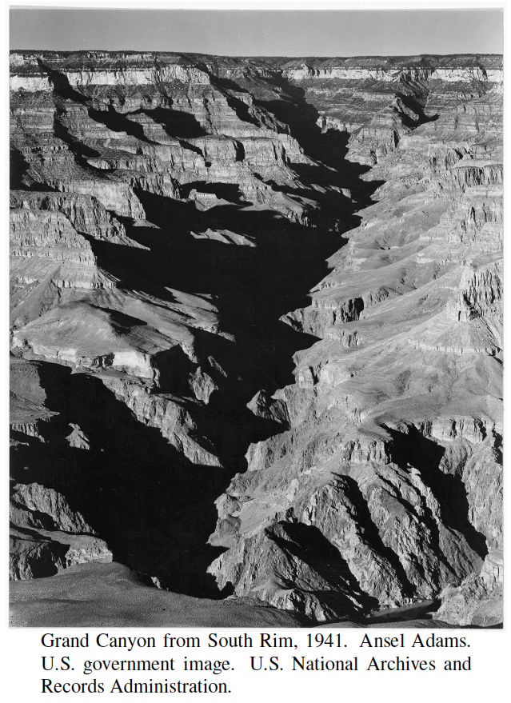
Divide-and-Conquer
Presentation for use with the textbook, Algorithm Design and Applications, by M. T. Goodrich and R. Tamassia, Wiley, 2015

Slide 2
Divide-and-Conquer
Divide-and conquer is a general algorithm design paradigm:
Divide: divide the input data S in two or more disjoint subsets S₁, S₂, …
Conquer: solve the subproblems recursively
Combine: combine the solutions for S₁, S₂, …, into a solution for S
The base case for the recursion are subproblems of constant size
Analysis can be done using recurrence equations

Slide 3
Merge-Sort Review
Merge-sort on an input sequence S with n elements consists of three steps:
Divide: partition S into two sequences S₁ and S₂ of about n/2 elements each
Conquer: recursively sort S₁ and S₂
Combine: merge S₁ and S₂ into a unique sorted sequence
Algorithm mergeSort(S)
Input sequence S with n elements
Output sequence S sorted
according to C
if S.size() > 1
(S₁, S₂) ← partition(S, n/2)
mergeSort(S₁)
mergeSort(S₂)
S ← merge(S₁, S₂)

Slide 4
Recurrence Equation Analysis
The conquer step of merge-sort consists of merging two sorted sequences, each with n/2 elements and implemented by means of a doubly linked list, takes at most bn steps, for some constant b.
Likewise, the basis case (n < 2) will take at b most steps.
Therefore, if we let T(n) denote the running time of merge-sort:
We can therefore analyze the running time of merge-sort by finding a closed form solution to the above equation.
That is, a solution that has T(n) only on the left-hand side.

Slide 5
Iteration method
In the iterative substitution technique, we iteratively apply the recurrence equation to itself and see if we can find a pattern:
When to stop ? When we arrive at the base case, which happens at level i = log n, That is n = 2^{i}.
So,
Thus, T(n) is O(n log n).

Slide 6
The Recursion Tree
Draw the recursion tree for the recurrence relation and look for a pattern:
depth | T’s | size
0 | 1 | n
1 | 2 | n/2
i | 2^{i} | n/2^{i}
… | … | …
time
bn
bn
bn
…
Total time = bn + bn log n
(last level plus all previous levels)

Slide 7
Master Method
Many divide-and-conquer recurrence equations have the form:
The Master Theorem:

Slide 8
Master Method
Many divide-and-conquer recurrence equations have the form:
a ≥ 1 is the number of subproblems
b ≥ 2 is the factor by which the subproblem size decreases
c > 0
a, b, c are real constants
f (n) = work to divide/merge subproblems

Slide 9
Master Method: Pitfalls
You cannot use the Master Theorem if
– T(n) is not monotone, e.g. T(n) = sin(x)
– f(n) is not a polynomial, e.g., T(n) = 2T(n/2) + 2^{n}

Slide 10
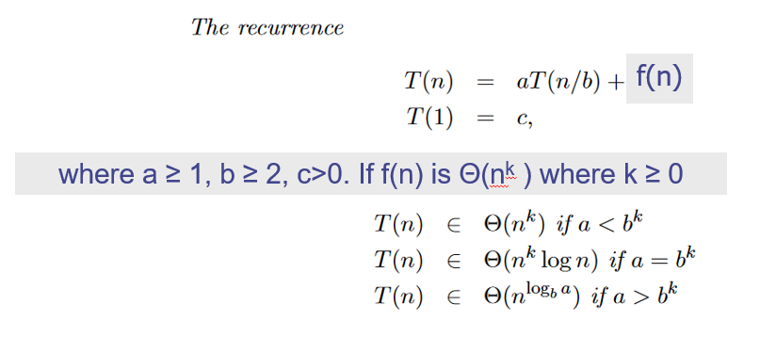
Master Method

Slide 11
Master Method, Example 1
Example:
Analyze the recurrence relation. Can Master Theorem be applied ?
Apply Master Theorem:
a = 4, b = 2, k = 1
4 > 2¹ => Case 3
Solution: log_{b}a = 2, so case 3 says T(n) is Θ(n²)

Slide 12
Master Method, Example 2
Example:
Analyze the recurrence relation. Can Master Theorem be applied ?
Apply Master Theorem:
a = 2, b = 2, k = 1
Part 2 from Zybooks
Solution: log_{b}a = 1, so Part 2 says if f(n) is Θ(n log n), which it is;
Then T(n) = Θ(n log² n)

Slide 13
Master Method, Example 3
Example:
Analyze the recurrence relation. Can Master Theorem be applied ?
Apply Master Theorem:
a = 8, b = 2, k = 2
8 > 2² => Case 3
Solution: log_{b}a = 3, so case 3 says T(n) is Θ(n³)

Slide 14

Master Method, Example 4
Example:
Analyze the recurrence relation. Can Master Theorem be applied ?
Apply Master Theorem:
a = 2, b = 4, k = 1/2
2 = 4^{1/2} => Case 2
Note f(n) = Θ(n^{1/2})
Solution: log_{b}a = 1/2, so case 2 says T(n) is Θ(n^{1/2} log n)

Slide 15
Sketch of Proof of the Master Theorem
Using iterative substitution, let us see if we can find a pattern:

Slide 16
Integer Multiplication
Algorithm: Multiply two n-bit integers I and J.
Divide step: Split I and J into high-order and low-order bits
We can then define I*J by multiplying the parts and adding:
So, T(n) = 4T(n/2) + n, which implies T(n) is Θ(n²)
But that is no better than the algorithm we learned in grade school.
Refer to participation activities 11.3.1 and 11.3.2

Slide 17
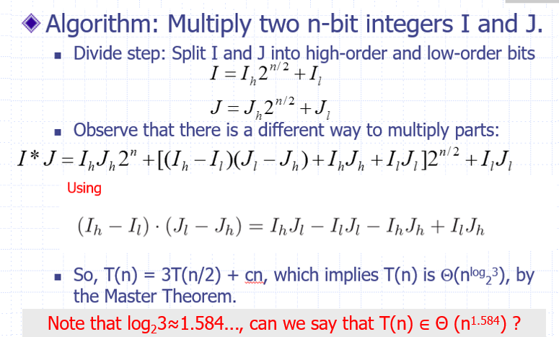
An Improved Integer Multiplication Algorithm: Karatsuba algorithm

